Slide 1
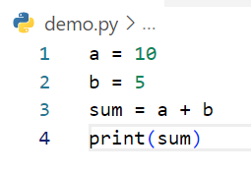
Write step following code below
Step | a | b | sum | output
1 | 10
2 | 10 | 5
3 | 10 | 5 | 15
4 | 10 | 5 | 15 | 15
Example

Slide 2
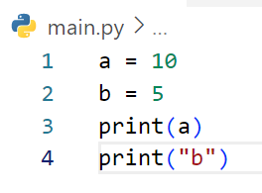
Write step following code below
Step | a | b | output
1 | 10
2 | 10 | 5
3 | 10 | 5 | 10
4 | 10 | 5 | b

Slide 3
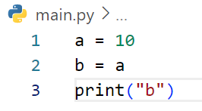
Write step following code below
Step | a | b | output
1 | 10
2 | 10 | 10
3 | 10 | 10 | b

Slide 4
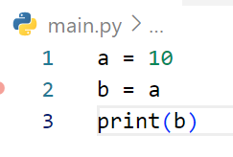
Write step following code below
Step | a | b | output
1 | 10
2 | 10 | 10
3 | 10 | 10 | 10

Slide 5
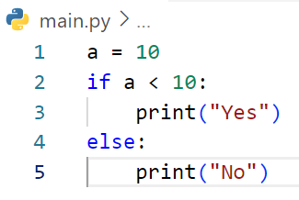
Write step following code below
Step | a | a<10 | output
1 | 10
2 | 10 | False
3 | 10 | False | No

Slide 6
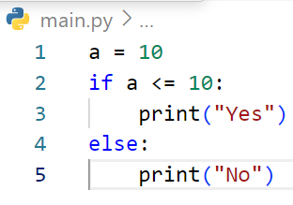
Write step following code below
Step | a | a <= 10 | output
1 | 10
2 | 10 | Truse
 | 10 | True | yes

Slide 7
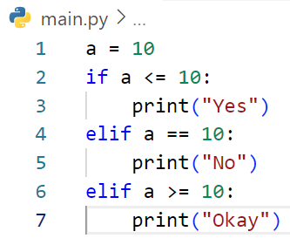
Write step following code below
Step | a | a < =10 | a == 10 | a >=10 | output
1 | 10
2 | 10 | True
3 | 10 | True |  |  | Yes
4 | 10 | False | False | False
5 | 10 | False | False | False
6 | 10 | False | False | False
7 | 10 | False | False | False

Slide 8
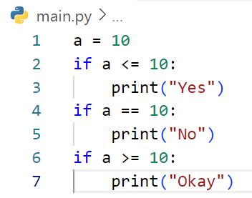
Write step following code below
Step | a | a <= 10 | a == 10 | a >= 10 | output
1 | 10
2 | 10 | True
3 | 10 | True |  |  | Yes
4 | 10 | True | True
5 | 10 | True | True |  | No
6 | 10 | True | True | True
7 | 10 | True | True |  | Okay

Slide 9
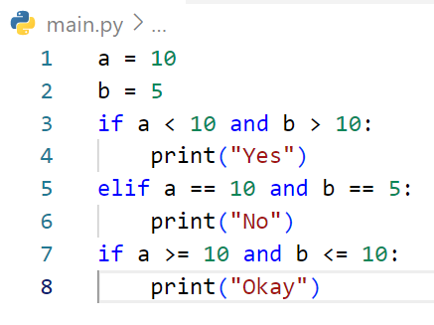
Write step following code below
Step | a | b | a < 10 and b >10 | a < 10 and b >10 | a < 10 and b >10 | output
1 | 10
2 | 10 | 5
3 | 10 | 5 | Fales
4 | 10 | 5 | Fales
5 | 10 | 5 | Fales | True
6 | 10 | 5 | Fales | True |  | No
7 | 10 | 5 | Fales | True | True
8 | 10 | 5 | Fales | True |  | Okay

Slide 10
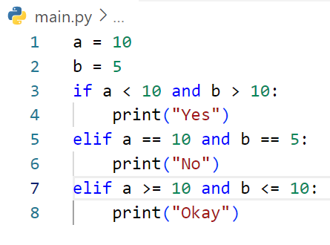
Write step following code below
Step | a | b | a < 10 and b >10 | a ==10 and b ==10 | a >= 10 and b <=10 | output
1 | 10
2 | 10 | 5
3 | 10 | 5 | False
4 | 10 | 5 | False
5 | 10 | 5 | False | True
6 | 10 | 5 | False | True |  | No
7 | 10 | 5 | False | True | False
8 | 10 | 5 | False

Slide 11
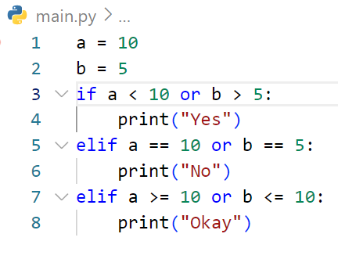
Write step following code below
Step | a | b | a < 10 or b >5 | a ==10 or b ==5 | a >= 10 or b <=10 | output
1 | 10
2 | 10 | 5
3 | 10 | 5 | False
4 | 10 | 5 | False
5 | 10 | 5 | False | True
6 | 10 | 5 | False | True |  | No
7 | 10 | 5 | False | True | False
8 | 10 | 5 | False

Slide 12
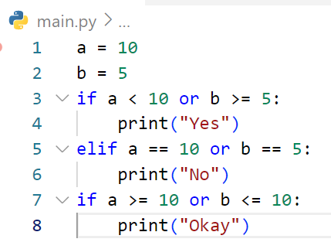
Write step following code below
Step | a | b | a < 10 or b >=5 | a ==10 or b ==5 | a >= 10 or b <=10 | output
1 | 10
2 | 10 | 5
3 | 10 | 5 | True
4 | 10 | 5 | True |  |  | Yes
5 | 10 | 5 | True | False
6 | 10 | 5 | True | False
7 | 10 | 5 | True | False | True
8 | 10 | 5 | True | False | True | Okay

Slide 13
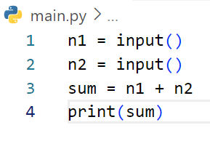
Write step following code below
# If user enter first : 3 and second 5
Step | n1 | n2 | sum | output
1 | 3
2 | 3 | 5
3 | 3 | 5 | 35
4 | 3 | 5 |  | 35

Slide 14
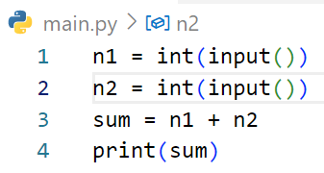
Write step following code below
# If user enter first : 3 and second 5
Step | n1 | n2 | sum | output
1 | 3
2 | 3 | 5
3 | 3 | 5 | 8
4 | 3 | 5 |  | 8

Slide 15
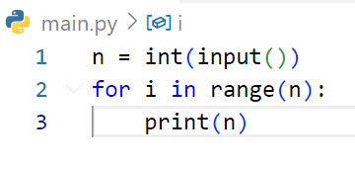
Write step following code below
# If user enter : 3
Step | n | i | output
1 | 3
2 | 3 | 0
3 | 3 | 0 | 0
4 | 3 | 1
5 | 3 | 1 | 1
6 | 3 | 2
7 | 3 | 2 | 2

Slide 16
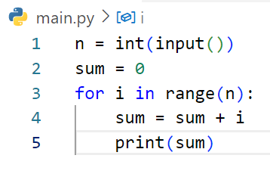
Write step following code below
Step | i | n | sum | output
1 | 0
2 | 0 | 3
3 | 0 | 3 | 0
4 | 0 | 3 |  | 0
5 | 1 | 3 | 1
6 | 1 | 3 |  | 1
7 | 2 | 3 | 1
8 | 2 | 3 |  | 3
# If user enter : 3

Slide 17
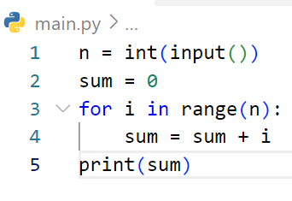
Write step following code below
Step | i | n | sum | output
1 | 0
2 | 0 | 2
3 | 1 | 2 | 1
4 | 1 | 2 |  | 1
# If user enter : 2

Slide 18
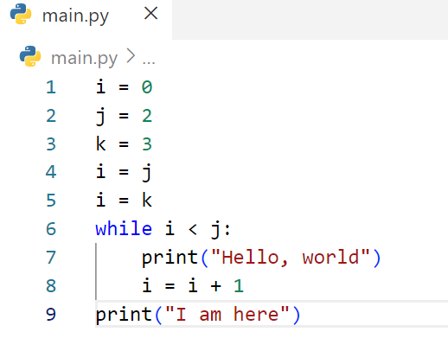
Write step following code below
Step | i | j | k | I < j | output
1 | 0
2 | 0 | 2
3 | 0 | 2 | 3
4 | 2 | 2 | 3
5 | 3 | 2 | 3
6 | 3 | 2 | 3 | False
7 |  |  |  |  | I am here

Slide 19
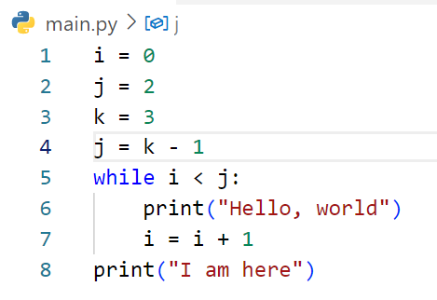
Write step following code below
Step | i | j | k | i<j | output
1 | 0
2 | 0 | 2
3 | 0 | 2 | 3
4 | 2 | 2 | 3
5 | 2 | 2 | 3 | Truse
6 | 2 | 2 | 3 | True | Hello , world
7 | 2 | 2 | 3 | False
8 |  |  |  |  | I am here

Slide 20
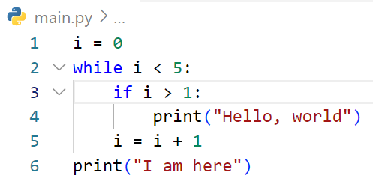
Write step following code below
Step | i | i < 5 | i >1 | output
1 | 0
2 | 0 | True
3 | 0 | True | False
4 | 0 | True
5 | 1 | True | False
6 | 1 | True
7 | 2 | True | True
8 | 2 | True |  | Hello , world
9 | 3 | True | True
10 | 3 | True |  | Hello , world
11 | 4 | Ture | True
12 | 4 | True |  | Hello, world
13
14 |  | False |  | I am here

Slide 21
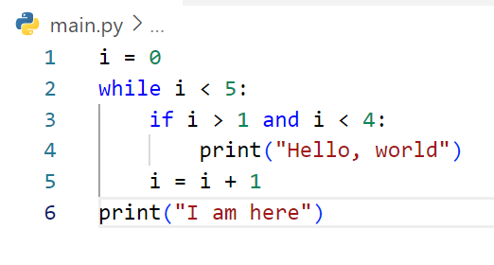
Write step following code below
Step | i | i<5 | i>1 and i<4 | output
1 | 0
2 | 0 | True
3 | 0 | True | False
4 | 0 | True
5 | 1 | True | False
6 | 1 | True
7 | 2 | True | True
8 | 2 | True |  | Hello, world
9 | 3 | True | True
10 | 3 | True |  | Hello, world
11 | 4 | True | False
12 | 5 | False
13 | 5 |  |  | I am here

Slide 22
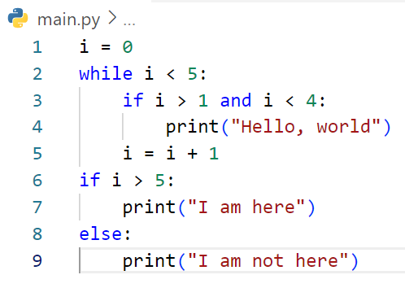
Write step following code below
Step | i | i<5 | i>1 and i<4 | i>5 | output
1 | 0
2 | 0 | True
3 | 0 | True | False
4 | 0 | True
5 | 1 | True | False
6 | 1 | True
7 | 2 | True | True
8 | 2 | True |  |  | Hello, world
9 | 3 | True | True
10 | 3 | True |  |  | Hello, eorld
11 | 4 | True | False
12 | 4 | True
13 | 5 | False |  | False
14 | 5 |  |  |  | I am not here

Slide 23
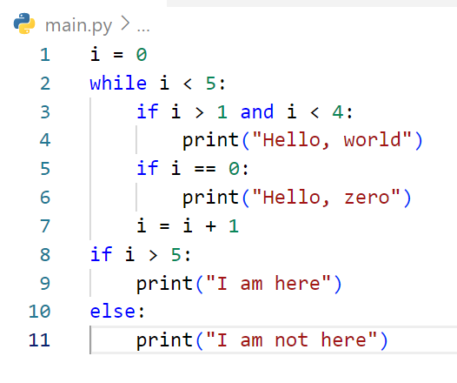
Write step following code below
Step | i | i<5 | i>1 and i<4 | i==0 | i>5 | output
1 | 0
2 | 0 | True
3 | 0 | True | False
4 | 0 | True | True | True
5 | 0 | True | True | True |  | Hello, zero
6 | 1 | True | False
7 | 1 | True
8 | 2 | True
9 | 2 | True | True
10 | 2 | True | True |  |  | Hello, world
11 | 3 | True
12 | 3 | True | True
13 | 3 | True | True |  |  | Hello, world
14 | 4 | True
Step | i | i<5 | i>1 and i<4 | i==0 | i>5 | output
15 | 4 |  | False
16 | 5 | False
17 | 5 | False |  |  | False
18 | 5 | False |  |  | False | I am not here

Slide 24
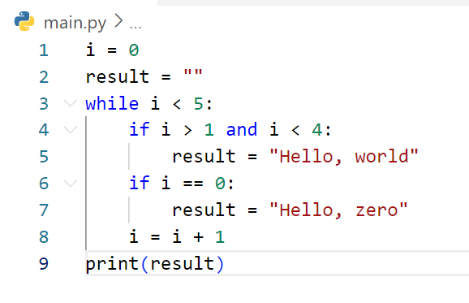
Write step following code below
Step | i | result | i<5 | i>1 and i<4 | i==0 | output
1 | 0
2 | 0 | “ ”
3 | 0 | “ “ | True
4 | 0 | “ ” | True | False
5 | 0 | “ ” | True | False | True
6 | 0 | “Hello, zero” | True | False | True | Hello, zero
7 | 1 | “Hello, zero” | True
8 | 1 | “Hello, zero” | True | False
9 | 1 | “Hello, zero” | True | False | False
10 | 2 | “Hello, zero” | True
11 | 2 | “Hello, zero” | True | True
12 | 2 | “Hello, word” | True | True |  | Hello, world
13 | 2 | “Hello, word” | True |  | False
Step | i | result | i<5 | i>1 and i<4 | i==0 | output
14 | 2 | “Hello, word”
15 | 3 | “Hello, word” | True
16 | 3 | “Hello, word” | True | True
17 | 3 | “Hello, word” | True | true |  | Hello,world
18 | 4 | “Hello, word” | True
19 | 4 | “Hello, word” | True
20 | 4 | “Hello, word” |  | False

Slide 25
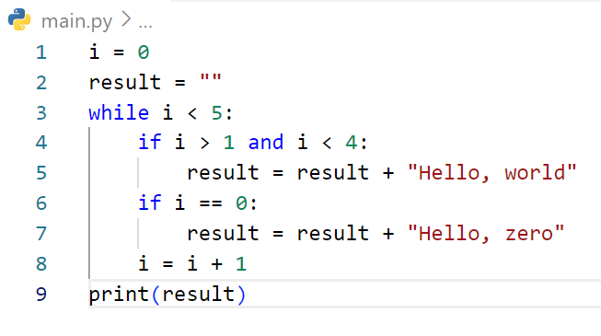
Write step following code below
Step | i | result | i <5 | i>1 and i<4 | i==0 | output
1 | 0
2 | 0 | “ ”
3 | 0 | “ ” | True
4 | 0 | “ ” | True | False
5 | 0 | “Hello, zero” | True | False | Teuse
6 | 1 | “Hello, zero” | True | False
7 | 1 | “Hello, zero” | True | False | False
8 | 2 | “Hello, zero” | True | True
9 | 2 | “Hello, word” | True | True | False
10 | 3 | “Hello, word” | True | True
11 | 3 | “Hello, word” | True | True | False
12 | 4 | “Hello, word” | True | False
13 | 4 | “Hello, word” | True | False | False | Hello, world

Slide 26
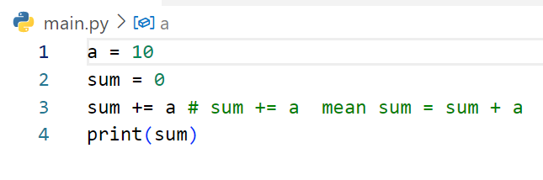
Write step following code below
Step | a | sum | output
1 | 10
2 | 10 | 0
3 | 10 | 10
4 | 10 | 10 | 10

Slide 27
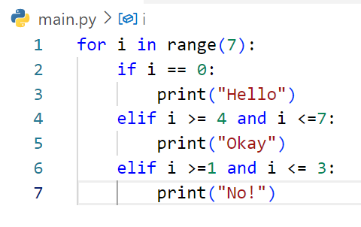
Write step following code below
Step | i | i==0 | i>=4 and i<=7 | i>=1 and <=3 | output
1 | 0
2 | 0 | True
3 | 0 | True | False | False | Hello
5 | 1 | False | False
6 | 1 | False | Falsse | True
7 | 1 | False | Falsse | True | No
9 | 2 | false | Falsse
10 | 2 | false | Falsse | Truse | No
11 | 3 | false | False
12 | 3 | false | Falsse | Truse | No
13 | 4 | false | true
14 | 4 | false | True | False | Okay
Step | i | i==0 | i>=4 and i<=7 | i>=1 and <=3 | output
15 | 5 | false
16 | 5 | false | True | False | Okay
17 | 6 | False
18 | 6 | false | True | False | Okay

Slide 28
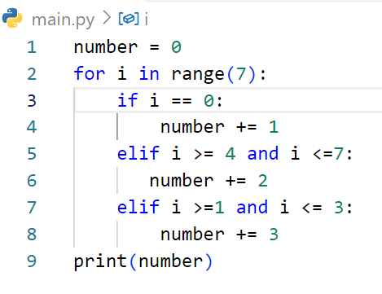
Write step following code below
Step | i | number | i==0 | i>=4 and i=7 | i>=1 and i<=3 | output
 |  | 0
 | 0 | 0 | True | False | False
 | 1 | 1 | False | False | Truse
 | 2 | 4 | False | False | True
 | 3 | 7 | False | False | True
 | 4 | 10 | False | False | True | 10

